Slide 1
FUNDAMENTALS OF THINKING IN PROGRAMMING

Slide 2
INTRODUCTION TO LOGIC
BASIC DEFINITIONS
IMPORTANCE IN PROGRAMMING
APPLICATIONS
Logic as Framework: Logic serves as the foundation for reasoning in programming.
Purpose: It's essential for effective problem-solving.
Significance: Understanding logic is crucial for any programmer to develop efficient and correct code.
Algorithms: Logic forms the structure for systematic problem-solving.
Decision-Making: Facilitates defined, consistent decision-making processes in programs.
Efficiency: Enables code optimization for improved performance and reliability.
Conditionals: Enables decision-making based on specific conditions.
Loops: Manages repetitive tasks efficiently until a condition is met.
Debugging: Assists in identifying and resolving errors by following logical steps.
Outcome: Proficiency in logic enhances overall programming effectiveness and results.

Slide 3
LOGIC CONNECTORS & GATES
CONNECTOR/GATE | FUNCTION | EXAMPLE
AND Gate | Outputs true only if both inputs are true | A AND B
OR Gate | Outputs true if at least one input is true | A OR B
NOT Gate | Outputs the inverse of the input | NOT A
NAND Gate | Outputs false only if both inputs are true | A NAND B
FUNDAMENTALS OF THINKING IN PROGRAMMING

Slide 4
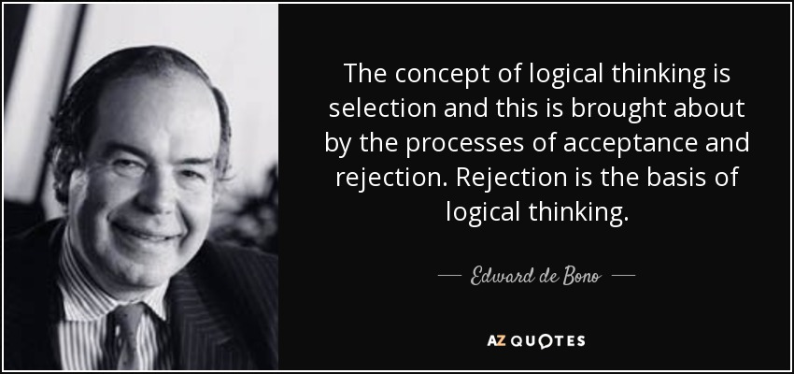
HUMAN VS. COMPUTER LOGIC
Computer Logic:
Binary: Operates strictly within 0s and 1s, requiring exact instructions.
Rule-Based: Follows predefined logical rules without deviation.
Consistent: Provides the same output for the same input every time.
Human Logic:
Intuitive: Often based on feelings or experiences rather than formal logic.
Flexible: Can handle ambiguous or incomplete information.
Emotional: Decisions can be influenced by emotions or personal biases.

Slide 5


DEFINING THINKING
CREATIVE PROBLEM SOLVING
Thinking in programming also requires creativity to devise unique solutions. Balancing analytical and creative skills leads to better programming practices.
ANALYTICAL SKILLS
In programming, thinking involves breaking down complex problems into manageable parts. This analytical approach is critical for effective code development.

Slide 6

SEQUENTIAL THINKING
CONCEPT OF SEQUENTIAL THINKING
Sequential thinking in programming is the ability to process information in a linear order. This is vital for executing instructions correctly.

Slide 7

CONNECTING TO PROGRAMMING BASICS
REAL-WORLD APPLICATIONS
Understanding these principles enhances programming skill application, leading to more efficient and effective coding.
FUNDAMENTAL PRINCIPLES
At its core, programming is about implementing logic, which directly relates to the concepts discussed earlier, such as logical connectors and thinking processes.

